Slide 1
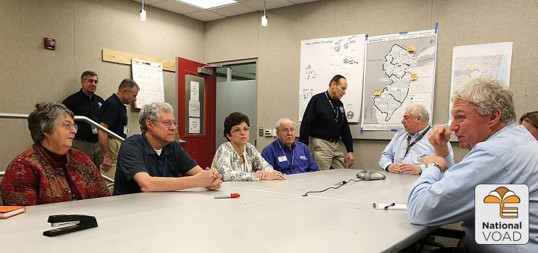
National Voluntary Organizations Active in Disaster
Developing Strong Partnerships with Government

Slide 2
Presentation Objectives
Identify successful practices for forming and doing work through partnerships with government
Understand the needs and motivations of potential government partners
Understand your own organization and what it can bring to a partnership
Learn to target a recruiting message to potential partners

Slide 3
Working Definition of Partnership ...
a mutually-beneficial working relationship entered into by organizations* in which each partner has needs and brings value.

Slide 4
Identifying Traits of Successful Partnerships with Government
Our most successful with government partnerships were...
List the signs that let you know a partnership has been successful:
1.
2.
3.
Notes:
Facilitator: Below are some activities and information to support this slide.
Partnerships… the good, the bad, the ugly. We’ve seen them in all configurations. The activity we’re about to do will help us identify successful practices for forming partnerships and conducting work through partnerships.
Stage 1:
[Facilitator will put brainstormed ideas on flip chart.]
In general terms, first (for 30 seconds) how do you know you’ve been in a successful partnership. What are the signs that a partnership has been successful?
[Potential answers: The stated mission was completed; we raised the money we said we would; we helped more people..]
As we look at this, based on your experience and knowledge of successful partnerships: list the characteristics that made those partnerships successful. We are just going to brainstorm; there are no restrictions. Just to clarify: we’re not asking what the partnership did, but what was it about the partnership or collaboration or working with another organization that worked… what were the contributing factors to the success or failure of these partnerships?
Remember these are partnerships that include volunteers…
Stage 2:
Let’s look at this last list. We see that some characteristics are about the relationships we build with partners and some are about the actual work we do together.
Ask “which characteristics address relationships? (Write an R beside these characteristics)
Ask “which characteristics address the actual work? (Write a W beside these characteristics)
[Facilitate and draw conclusion from the patterns… ]
As you start a new partnership or enhance an ongoing partnership, consider the time spent on fostering relationships compared to planning the work tasks. We need to continually think about skills, knowledge, and training that would help partners balance the relationship skills, as well as the work planning skills.
It’s also important to note that it takes paying attention to both the work and relationships aspects of partnerships to make a successful partnership. It is also necessary to have a clear objective for the partnership. This helps you strategically select partners for the project.

Slide 5
Activities of a Successful Partnership with Government
List contributing factors to the success or failure of these partnerships:
1.
2.
3.
Let’s look at this last list. Note that some of the characteristics are probably about the relationships we build with partners and some are about the actual work we do together.

Slide 6
Relationship Building
It takes paying attention to both the work and relationship aspects of partnerships to make a successful partnership.
As you start a new partnership or enhance an ongoing one, consider the time spent on fostering relationships compared to planning work tasks. It is critical that attention be paid to the development of skills, knowledge, and training that helps partners balance the relationship building needs with the work of the partnership.

Slide 7
Nonprofit-Business-Government Cultural Differences for Multi-Sector Partnerships
Let’s take a moment to frame our discussion about developing successful partnerships that engage volunteers. Often, these partnerships cross sectors and engage us in relationships with partners from all three sectors (business, nonprofit, and government).
One thing we’ve learned is that all three sectors need to develop a mutual understanding of one another and their respective agenda, cultures, and operating practices in order to develop effective partnerships.
Notes:
Facilitator: You may want to discuss these elements.
Let’s take a moment to frame our discussion about developing successful partnerships that engage volunteers. Often, these partnerships cross sectors and engage us in relationships with partners from all three sectors (business, nonprofit, and government). One thing we’ve learned is that all three sectors need to develop a mutual understanding of one another and their respective agenda, cultures and operating practices in order to develop effective partnerships.
Acknowledging these differences can help you better understand the motivations of different sectors to be a part of a partnership. Stage one in developing any partnership is recognizing your needs and then recognizing their needs.

Slide 8
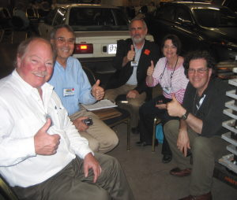
Nonprofit - Business - Government Cultural Differences for Multi-Sector Partnerships
Research indicates that cross-sector partnering is distinctive from other types of partnering because the participants in any such alliance are more likely to have noticeably different styles of:
Language or jargon
measurement of success
performance measures
pace
decision-making styles
competition
organizational cultures
Notes:
Facilitator: You may want to discuss these elements.
Research indicates that cross-sector partnering is distinctive from other types of partnering because the participants in any such alliance are more likely to have noticeably different styles of: language or jargon, measures of success, performance measures, pace, decision-making styles, competition, organizational cultures…
And I’m sure you can think of many more.
As you think about what you bring to a partnership in terms of strengths, it is also important to consider what you bring in terms of other characteristics as well.
Two examples:
1: Measuring Success
When different partners think about measuring success: what might different groups measure? [Potential answers: nonprofits: number of volunteers engaged; business: increased services to employees or families/increased skills building opportunities; government: reduced or status quo expenditure on service delivery]
2. Pacing
Nonprofit or government agencies may have more layers of people who have to give approval (i.e. funders, legal departments, staff), while businesses may be able to provide decisions more quickly. This could set up conflicts in pacing if it isn’t acknowledge up front and built into the timeline for the project.
[Facilitator ask: What differences have we seen in these areas in partnerships in which we have been engaged? List answers.]

Slide 9
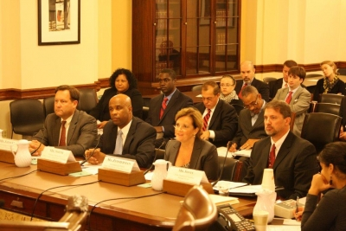
Nonprofit - Business - Government Cultural Differences for Multi-Sector Partnerships
As you think about what you bring to a partnership in terms of strengths, it is also important to consider what you bring in terms of other characteristics as well.
What are some of those characteristics:
1.
2.
3.

Slide 10
Standards for Partnership Excellence
The Partnership Standards of Excellence is a guideline to help organizations improve their chances of a successful partnership and to help measure the quality of their partnerships.
Several years ago, Connect America, a program of the Points of Light Foundation, established a focus group of nonprofit, business, government, and community leaders with experience in multi-sector partnerships and organizational leadership to help develop and validate the Partnership Standards of Excellence.

Slide 11
Standards for Partnership Excellence
Standards for Processes and Procedures for Creating Partnerships that Work…
Manage the partnership’s work with a plan that drives toward outcomes.
Foster and manage the partnership’s working relationships as thoroughly as the partnership’s work.
Engage volunteers effectively throughout the work of the partnership.

Slide 12
1. Manage the partnership’s work with a plan that drives toward outcomes.
Has the partnership developed a vision statement and desired outcomes? Is the focus on the community issues that need to be addressed?
Is there a written action plan with desired outcomes, goals strategies, evaluation system, timeline, and budget?
Does the partnership evaluate its work as well as the working relationships and the engagement of volunteers?

Slide 13
2. Foster and manage the partnership’s working relationships as thoroughly as the partnership’s work.
Does the partnership have a charter, such as a Memorandum of Understanding or a letter of agreement that states the purpose of the partnership and identifies roles and responsibilities for the partnering organization, including volunteers?
Do the participating organizations view the partnership as a mutually beneficial relationship in which each partner brings value and receives value?
Are you fostering positive relationships in the partnership? Are you being flexible, communicating, and accountable?

Slide 14
3. Engage volunteers effectively throughout the work of the partnership.
Are volunteers seen as valuable resources?
Are they engaged?
Are the roles of volunteers in the partnership clearly defined?
Are volunteer contributions recognized?

Slide 15
5 Steps to Begin Successful Partnerships
Understand your own organization
Understand needs and motivation of the other organization
Identify common interests
Plan together, plan early , and put it in writing
Agree on roles, tasks and responsibilities
And ...Celebrate!
communicate  communicate  communicate
Plan Exercise Train
Notes:
Facilitator: Share the questions below with those in the meeting.
Understand your own organization:
What do you need/ want?
What do you offer?
Is your organization ready to partner?
Understand needs and motivation of the other organization:
What do they want?
What can they offer?
What is your history with them?
What opportunities are you bringing?
Identify common interests:
Identify community leaders who can convene others.
Articulate issue in terms of needs of community and people.
Articulate vision of clearly understood positive outcomes.
Consider who else should be ‘at the table’?
Plan together, plan early, and put it in writing:
Gather information from partners about desired outcome or expected results
Articulate the broadly worded goals or desired results
Small group takes the information to draft a work plan
Present draft work plan to partnership for feedback
Modify draft
Present modified version to partnership for acceptance
Agree on roles, tasks, and responsibilities:
Clearly define the roles and responsibilities related to the partnership in the partnership agreement.
Celebrate:
Okay, there is a sixth step. Celebrate the successes of the partnership along the way; don’t wait for it to be over to recognize your accomplishments.
It’s important to acknowledge that not all partnerships work. Some partnerships don’t and need to be terminated. Knowing what works and thinking strategically about your needs and potential partner needs will also help you make this important decision (to terminate a partnership) as well.

Slide 16
5 Steps to Begin Successful Partnerships
1. Understanding your own organization
What do you need/want?
What do you offer?
Is your organization ready to partner?
2. Understand needs and motivation of the other organization
What do they want?
What can they offer?
What is your history with them?
What opportunities are you bringing?

Slide 17
5 Steps to Begin Successful Partnerships
3. Identify common interests
Identify community leaders who can convene others
Articulate issue in terms of needs of community and people
Articulate vision of clearly understood positive outcomes
Consider -- who else should be ‘at the table’
4. Plan together, plan early, and put it in writing
Gather information from partners about desired outcome or expected results
Articulate the broadly worded goals or desired results
Small group takes the information to draft a work plan
Present draft work plan to partnership for feedback
Modify draft
Present modified version to partnership for acceptance

Slide 18
5 Steps to Begin Successful Partnerships
5. Agree on roles, tasks and responsibilities
Clearly define the roles and responsibilities related to the partnership in the partnership agreement.
6. And ...Celebrate!
Okay, there is a sixth step. Celebrate the successes of the partnership along the way; don’t wait for it to be over to recognize your accomplishments.

Slide 19
Start a relationship off right …match making for partnerships
What do you have to offer?
What experiences, skills, opportunities are government partners looking for?
As you consider your answers, do you have in mind a company, nonprofit, government agency, or community of faith that you think matches your needs? Is it a group that you may not have considered before as a partner?
Consider your existing partnerships: do your needs and offerings still match? Do you or they have new resources to offer or needs to be addressed?
Notes:
Facilitator: Take a few minutes for participants to discuss the two key questions about targeting potential partners.
If the group is small, have them break into pairs. Have one member of the pair be your organization and the other represent a potential or existing partner. Have them consider: What does your organization/affiliate have to offer a potential partner (i.e. skills, assets, networks, common interest)? What do you think they would be looking for?
What does the other organization need from my organization to have to complement, supplement, or add to the partnership? [What experiences, opportunities, assets do you need them to bring to a partnership?]
Each pair or selected pairs will report out.
Record shared answers from the Large Group on a central flip chart.
As you look at these answers, do any of you have in mind a company, nonprofit, government agency, or community of faith that you think matches your needs? Is it a group that you may not have considered before as a partner?
If you have existing partners in the room, see if your needs and offerings still match. Do you or they have new resources to offer? Do you or they have new needs to be addressed?
If you have time: give participants a couple of minutes to compose a stoop speech or elevator speech to a potential partner using the information on what they have to offer and what their partner needs from them.

Slide 20
Stoop Speech
Think up a 1 minute stoop speech!
Knowing what you do about your assets and needs as a partner, if you only had 1 minute to interest a potential partner, what would you say?

Slide 21
Manage the relationships, not just the deal
For organizations in existing partnerships, it is critical to understand that successful partnerships manage the relationship and not just the initial deal. If you are in an existing partnership, this might be a good time to stop and conduct a partnership check-up: how well you are doing in the listed areas?
Managing the volunteers well
Checking your actions against the points of agreement
Asking for feedback on how well the organizations work together
Documenting the partnership’s successes
Communicating the successes with partners, staff, volunteers, the public, and policy makers
Notes:
Facilitators: You may want to facilitate a discussion around the following topic.
For organizations in existing partnerships, it is critical to understand the successful partnerships manage the relationship and not just the initial deal. If you are in an existing partnership, this might be a good time to stop and conduct a partnership check-up: how well you are doing in the above listed areas?
Do you have a process for managing volunteers that engages and mobilizes them to achieve both mission of your organization and the shared goals of the project and the partnership? Are volunteers excited about being part of the project? Do volunteers feel valued?
Are you following the terms of the agreement? Does the agreement need to be updated?
How well do the partner organizations feel they are working together? Do you have a mechanism in place to capture this feedback consistently (i.e. meetings or evaluation forms)?
Do you document your success (i.e. newsletter articles, reports, certificates, e-mails)?
Do you share your success with all the stakeholders (i.e. internal staff, other partners, funders, the public, policy makers)?

Slide 22
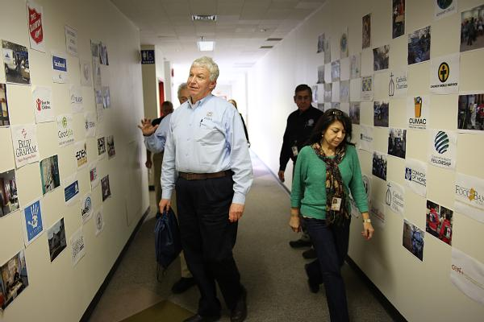
Think Long Term
Even if your needs are immediate and short-term, work so that you build long-term relationships with your partners.

Slide 23
Questions

